Slide 1
Chapter 2 – Software Processes

Slide 2
Topics covered
Software process models
Process activities
Coping with change
Process improvement

Slide 3
The software process
A structured set of activities required to develop a
software system.
Many different software processes but all involve:
  Specification – defining what the system should do;
  Design and implementation – defining the organization of the system and implementing the system;
  Validation – checking that it does what the customer wants;
  Evolution – changing the system in response to changing
customer needs.
A software process model is an abstract representation of a process. It presents a description of a process from some particular perspective.

Slide 4
Plan-driven and agile processes
Plan-driven processes are processes where all of the process activities are planned in advance and progress is measured against this plan.
In agile processes, planning is incremental and it is easier to change the process to reflect changing customer requirements.
In practice, most practical processes include elements of both plan-driven and agile approaches.
There are no right or wrong software processes.

Slide 5
Process activities

Slide 6
Process activities
Real software processes are inter-leaved sequences of technical, collaborative and managerial activities with the overall goal of specifying, designing, implementing and testing a software system.
The four basic process activities of specification, development, validation and evolution are organized differently in different development processes.
For example, in the waterfall model, they are organized in sequence, whereas in incremental development they are interleaved.

Slide 7
Software specification
The process of establishing what services are required and the constraints on the system’s operation and development.
Requirements engineering process
  Requirements elicitation and analysis
    What do the system stakeholders require or expect from the system?
  Requirements specification
    Defining the requirements in detail
  Requirements validation
    Checking the validity of the requirements

Slide 8
Software design and implementation
The process of converting the system specification into
an executable system.
Software design
  Design a software structure that realises the specification;
Implementation
  Translate this structure into an executable program;
The activities of design and implementation are closely
related and may be inter-leaved.

Slide 9
System implementation
The software is implemented either by developing a program or programs or by configuring an application system.
Design and implementation are interleaved activities for
most types of software system.
Programming is an individual activity with no standard process.
Debugging is the activity of finding program faults and correcting these faults.

Slide 10
Software validation
Verification and validation (V & V) is intended to show that a system conforms to its specification and meets the requirements of the system customer.
Involves checking and review processes and system
testing.
System testing involves executing the system with test cases that are derived from the specification of the real data to be processed by the system.
Testing is the most commonly used V & V activity.

Slide 11
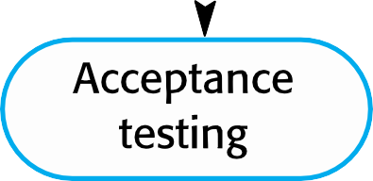
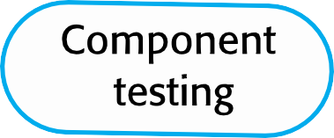
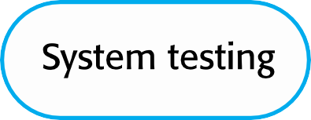
Stages of testing

Slide 12
Testing stages
Component testing
  Individual components are tested independently;
  Components may be functions or objects or coherent groupings of these entities.
System testing
  Testing of the system as a whole. Testing of emergent properties is particularly important.
Customer testing
  Testing with customer data to check that the system meets the customer’s needs.

Slide 13
Software evolution
Software is inherently flexible and can change.
As requirements change through changing business circumstances, the software that supports the business must also evolve and change.
Although there has been a demarcation between development and evolution (maintenance) this is increasingly irrelevant as fewer and fewer systems are completely new.

Slide 14
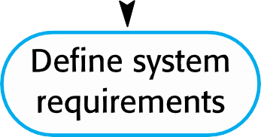
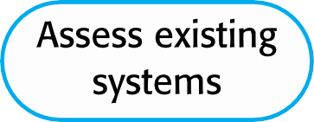
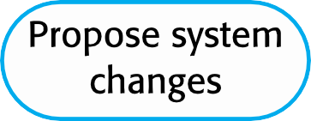
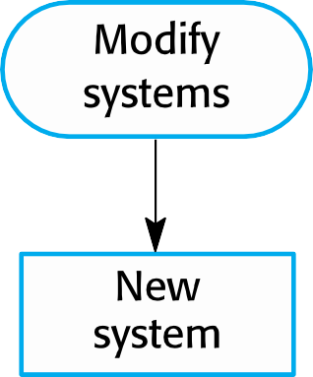
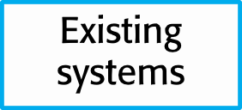
System evolution

Slide 15
Software process models

Slide 16
Software process models
The waterfall model
  Plan-driven model. Separate and distinct phases of specification and development.
Incremental development
  Specification, development and validation are interleaved. May be plan-driven or agile.
Integration and configuration
  The system is assembled from existing configurable components. May be plan-driven or agile.
In practice, most large systems are developed using a process that incorporates elements from all of these models.

Slide 17
Waterfall
A government contracts a firm to build a bridge.
Requirements are finalized, approved, and legally frozen.
Construction starts only after design completion.
Any change later costs millions.
Can construction start without a complete design?
Can the bridge be “iterated” after pouring concrete?
Classical Waterfall was designed for such environments—where change is expensive or dangerous.

Slide 18
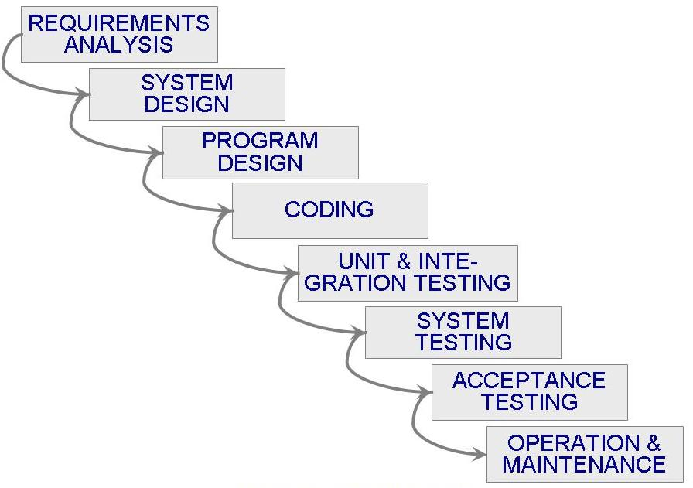
Waterfall Model

Slide 19
Waterfall model phases
There are separate identified phases in the waterfall
model:
  Requirements analysis and definition
  System and software design
  Implementation and unit testing
  Integration and system testing
  Operation and maintenance
The main drawback of the waterfall model is the difficulty of accommodating change after the process is underway. In principle, a phase has to be complete before moving onto the next phase.

Slide 20
Waterfall model problems
Inflexible partitioning of the project into distinct stages makes it difficult to respond to changing customer requirements.
  Therefore, this model is only appropriate when the requirements are well-understood and changes will be fairly limited during the design process.
  Few business systems have stable requirements.
The waterfall model is mostly used for large systems engineering projects where a system is developed at several sites.
  In those circumstances, the plan-driven nature of the waterfall
model helps coordinate the work.

Slide 21
Waterfall
Originated in 1970s
Documentation-heavy, compliance-driven environments
Low tolerance for failure (nuclear, banking)
Key message:
Classical Waterfall was not “bad design”—
it was rational design for a predictable world.

Slide 22
When to use waterfall model?
Clear and Stable Requirements
Large systems
Low Risk of Changes
Well-Defined Technology and Tools
Documentation-Driven Development

Slide 23
Waterfall
A payroll or census system delivered exactly as specified
User needs had changed by deployment time
Technically correct, practically useless
“What if we kept the structure—but allowed learning between phases?”

Slide 24

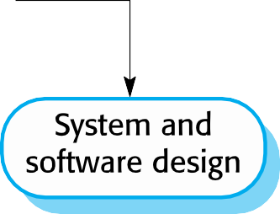
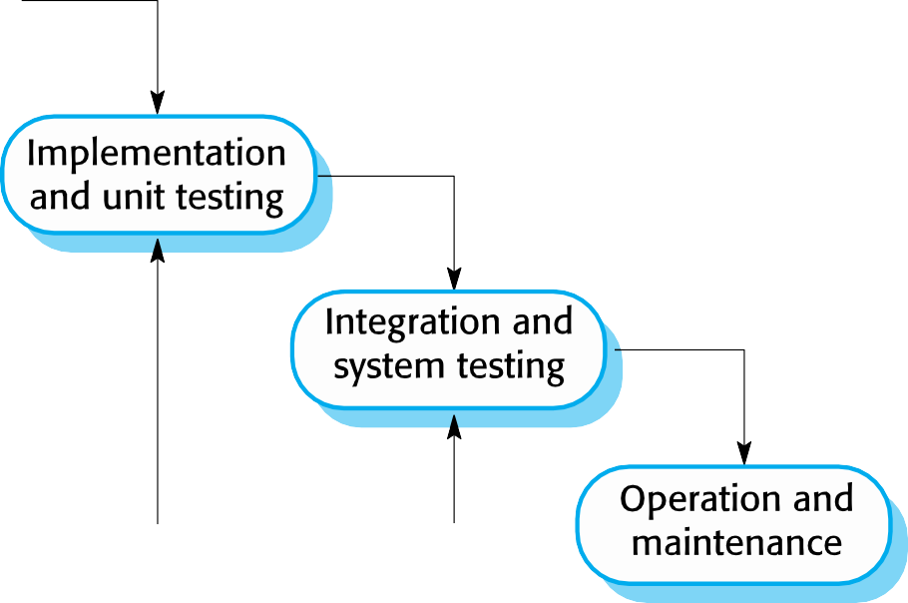
The modern waterfall model

Slide 25
Waterfall with feedback
Changes:
Overlapping phases
Early validation and verification
Limited backtracking
Continuous documentation updates

Slide 26
Waterfall
Use Classical Waterfall when:
Requirements are stable
Regulatory compliance is critical
Cost of change is extremely high
Use Modern Waterfall when:
Requirements are mostly stable
Feedback is possible but controlled
Large teams need structure

Slide 27
If testing is so important,
why is it always taught at the end of the Waterfall model?
The V-Model was created when engineers realized that testing
should not be an afterthought—it should be planned from day one.

Slide 28
Waterfall assumes:
  “First we build everything, then we test.”
Reality showed:
  Defects introduced early are costliest to fix later.
Every development phase must have a corresponding testing phase

Slide 29
V-Model
A variant of the waterfall model
Uses unit testing to verify procedural design
Uses integration testing to verify architectural (system) design
Uses acceptance testing to validate the requirements
If problems are found during verification and validation, the left side of the V can be re-executed before testing on the right side is re-enacted

Slide 30
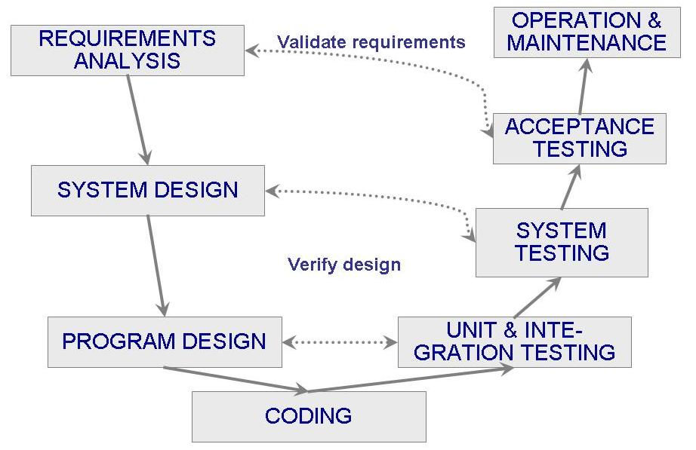
V-Model
Notes:
Verification=ensure product is built correctly, validation= ensure product meets user needs

Slide 31
Structure of the V-Model
The V-Model is divided into two main branches:
Verification Phases (Left Side of the "V"):
  These phases are concerned with the planning, design, and coding aspects of the project.
Validation Phases (Right Side of the "V"):
  These phases involve testing and validating the software to ensure that it meets the requirements set during the verification phases.

Slide 32
Phases of the V-Model
1. Requirements Analysis
Objective: Understanding and documenting the functional and non-functional requirements of the system.
Output: Requirements Specification Document.
Corresponding Testing Phase: Acceptance Testing
  Purpose: To validate that the system meets the business needs and requirements of the customer.
2. System Design
Objective: Designing the overall system architecture and data flow.
Output: System Design Documents.
Corresponding Testing Phase: System Testing
  Purpose: To ensure the system functions correctly as a whole and that it complies with the system specifications.

Slide 33
Phases of the V-Model
Implementation
Objective: Actual coding of the software components as per the Low-Level Design.
Output: Source Code.
Corresponding Testing Phase: Unit Testing
  Purpose: To ensure each unit of the code functions correctly and matches its design.

Slide 34
Benefits and Drawbacks if V-Model
Benefits of the V-Model
Early Detection of Defects
Structured Approach
Clear Milestones
Improved Quality
Customer Involvement
Drawbacks of the V-Model
Inflexibility
Not Suitable for Complex or Long-term Projects
High Dependence on Initial Requirements

Slide 35
When to Use the V-Model
The V-Model is most suitable for:
Projects with Clear Requirements: Where requirements are well-understood and unlikely to change.
Safety-Critical Systems: Such as in medical, or automotive industries, where rigorous testing and validation are critical.

Slide 36
Aspect | Waterfall Model | V-Model
Process Flow | Linear and sequential | V-shaped with corresponding testing for each phase
Testing Phase | Testing occurs after the entire development is complete | Testing is integrated at every stage of development
Flexibility | Less flexible; changes are difficult to implement | More flexible due to early defect detection
Risk Management | Higher risk of late defect discovery | Lower risk; defects are identified early
Project Suitability | Suitable for large projects with clear requirements | Suitable for projects requiring rigorous validation

Slide 37
Definitions
Iterate
to utter or do repeatedly
iteration n. – iterative adj
Increment n
1. amount of increase
2. a becoming greater or larger; increase
incremental adj

Slide 38
Incremental Development
Building and releasing one feature at a time depending on priorities defined by the customer
You have all the requirements
you design the complete product first. You only leave out details that you can safely decide later.
Then you slice it up into chunks and build each separately.
When you finish a chunk, aka module, you integrate it with previously completed parts, so they work as a whole.

Slide 39
Example: Ecommerce website
Consider a team building an ecommerce website using incremental development. The final target product has search, product information, a shopping basket, checkout, favourites, and customer reviews.
For the first released increment, the team builds the basic functionality to buy a product. It includes search, product information, adding products to a shopping basket and checkout. This first slice would only be released once it’s complete.
The second released increment builds on that basic functionality, and would add another capability such as favourites. The would be released when the favourites functionality is complete.
The third released increment adds customer reviews once that is complete, and so on.

Slide 40
Iterative Development
Iterative development is a lot like inventing: discovering what and how you need as you go.
Build the overall solution/product and then refine some of the areas that require improvement
You start with a fair idea of what you want the product to accomplish, and you use a process of successive approximation to design and build it.
You begin by designing, building, and testing the tiniest version of what you have in mind. When you’re happy, you show it and collect feedback from everybody with a stake in the product.
If what you created was well received, you keep it and expand on it in the next iteration. If what you created got the thumbs down, you discard it and go back to the drawing board

Slide 41
Example: Ecommerce website
Assume a team building the same ecommerce website using an iterative process.
The first release has a really stripped back version of all the required functionality; namely search, product information, a shopping basket, checkout, favourites, and customer reviews.
For the second iterative release, the team would improve some of the existing basic functionality, taking into account feedback from stakeholders or customer, or other inputs such as analytics.
On every subsequent iterative release, new ideas and requirements are added or low value/usage areas may be removed.

Slide 42
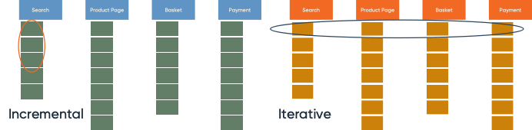
Example: Ecommerce website

Slide 43
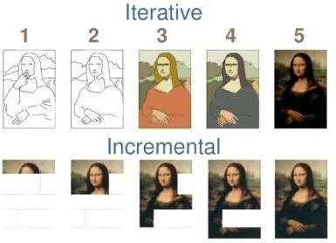
Example: Artist painting a picture

Slide 44
Coping with change

Slide 45
Coping with change
Change is inevitable in all large software projects.
  Business changes lead to new and changed system requirements
  New technologies open up new possibilities for improving
implementations
  Changing platforms require application changes
Change leads to rework so the costs of change include both rework (e.g. re-analysing requirements) as well as the costs of implementing new functionality

Slide 46
Coping with changing requirements
System prototyping, where a version of the system or part of the system is developed quickly to check the customer’s requirements and the feasibility of design decisions. This approach supports change anticipation.
Incremental delivery, where system increments are delivered to the customer for comment and experimentation. This supports both change avoidance and change tolerance.

Slide 47
Software prototyping
A prototype is an initial version of a system used to
demonstrate concepts and try out design options.
A prototype can be used in:
  The requirements engineering process to help with requirements
elicitation and validation;
  In design processes to explore options and develop a UI design;
  In the testing process to run back-to-back tests.

Slide 48
Benefits of prototyping
Improved system usability.
A closer match to users’ real needs.
Improved design quality.
Improved maintainability.
Reduced development effort.

Slide 49
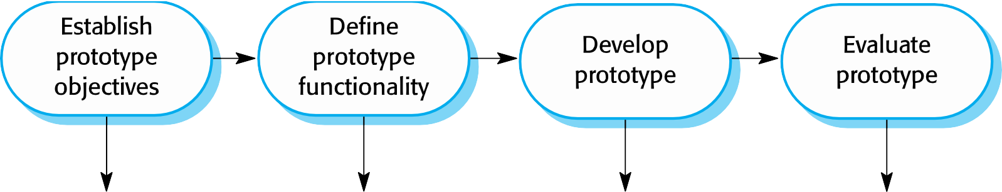
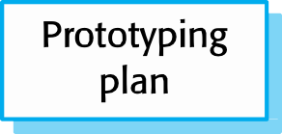
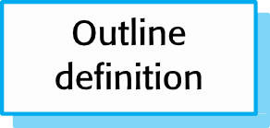
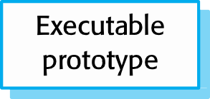
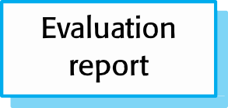
The process of prototype development

Slide 50
Prototype development
May be based on rapid prototyping languages or tools
May involve leaving out functionality
  Prototype should focus on areas of the product that are not well- understood;
  Error checking and recovery may not be included in the prototype;
  Focus on functional rather than non-functional requirements such as reliability and security

Slide 51
Throw-away prototypes
Prototypes should be discarded after development as
they are not a good basis for a production system:
  It may be impossible to tune the system to meet non-functional requirements;
  Prototypes are normally undocumented;
  The prototype structure is usually degraded through rapid change;
  The prototype probably will not meet normal organisational quality standards.

Slide 52

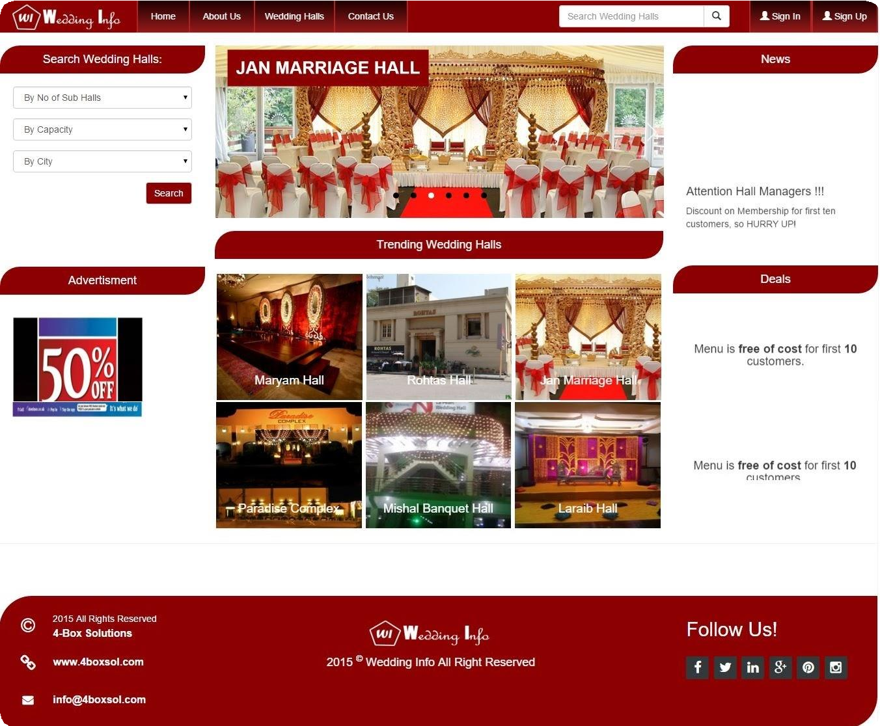

Slide 53
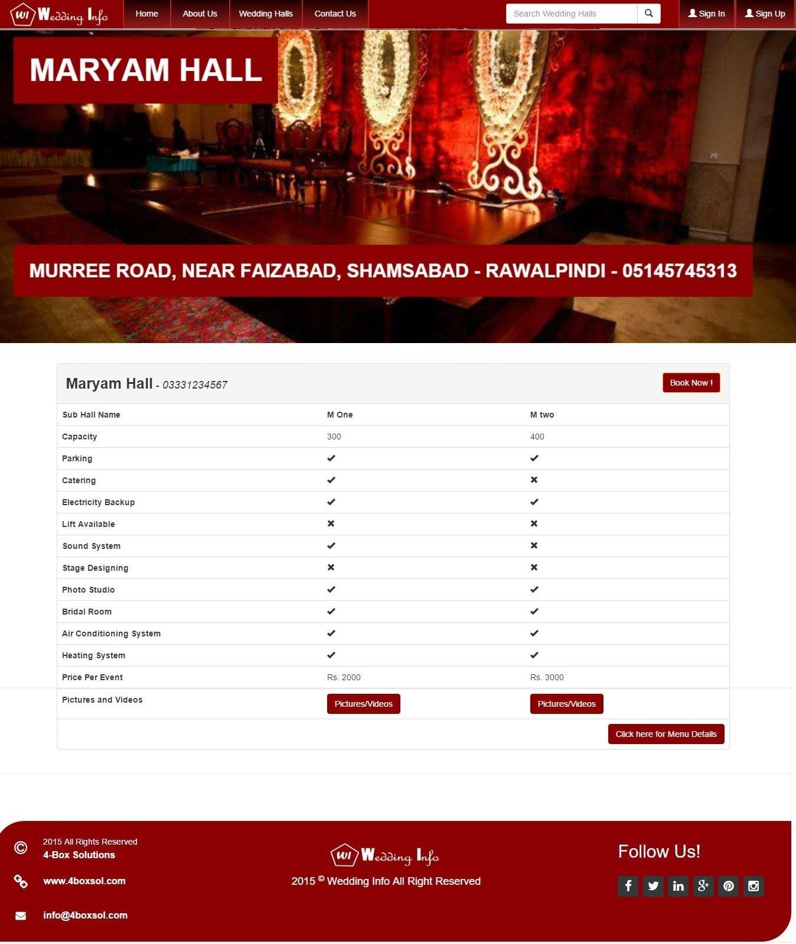

Slide 54
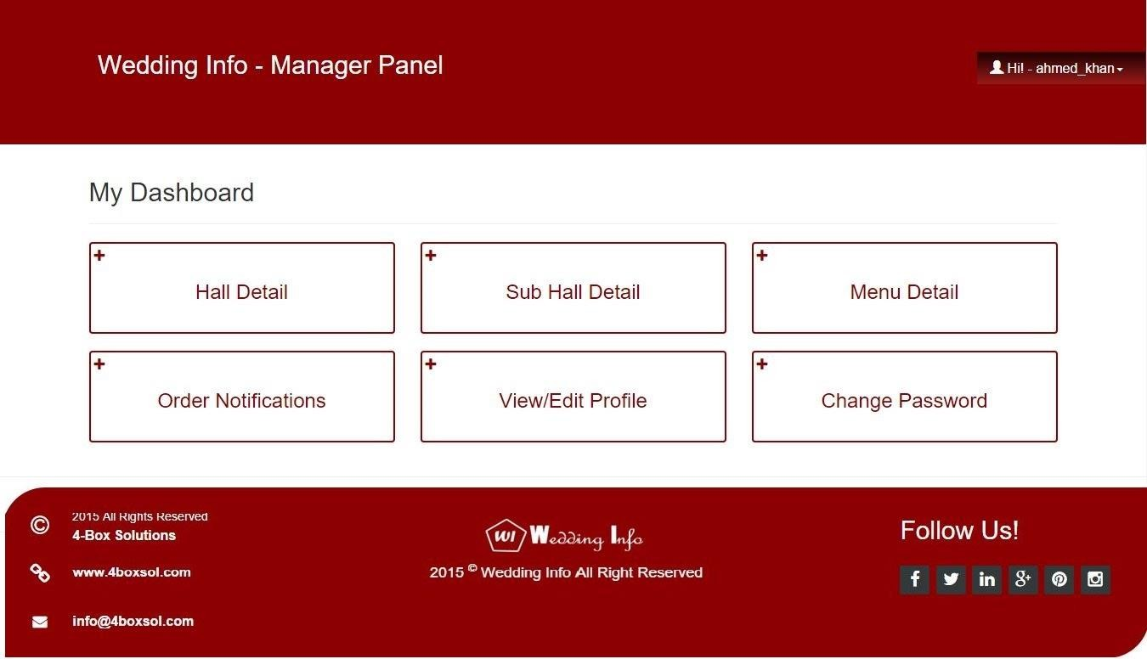

Slide 55
Tools
Figma

Slide 56
Boehm’s Spiral Model
Process is represented as a spiral rather than as a sequence of activities with backtracking.
Each loop in the spiral represents a phase in the process .
No fixed phases such as specification or design loops in the spiral are chosen depending on what is required.
Risks are explicitly assessed and resolved throughout the process.

Slide 57
Boehm’s Spiral Model
Process is represented as a spiral rather than as a sequence of activities with backtracking.
Each loop in the spiral represents a phase in the process .
No fixed phases such as specification or design loops in the spiral are chosen depending on what is required.
Risks are explicitly assessed and resolved throughout the process.
Notes:
The Spiral Model is a risk-driven process model that combines iterative development with systematic risk analysis.

Slide 58
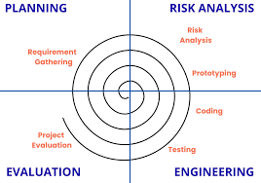
Boehm’s Spiral
Model

Slide 59
Spiral Model Usage
Spiral model has been very influential in helping people think about iteration in software processes and introducing the risk driven approach to development.
In practice, however, the model is rarely used:
Can be a costly model to use
Risk analysis requires highly specific expertise
Doesn’t work well for smaller projects.

Slide 60
When to use spiral model
The following pointers explain the typical uses of a Spiral Model −
For medium to high-risk projects.
Long-term project commitment because of potential changes to economic priorities as the requirements change with time.
Customer is not sure of their requirements which is usually the case.
Requirements are complex and need evaluation to get clarity.
New product line which should be released in phases to get enough customer feedback.
Significant changes are expected in the product during the development cycle.

Slide 61
Advantages & Disadvantages
Benefits | Drawbacks
Allows the use prototyping | Management is more complex
Client can see the system early on | Should not be used for small projects
Changes in requirements can be made easily | This method requires a lot of documentation

Slide 62
Aspect | Waterfall Model | V-Model | Spiral Model
When to Use | - Clear, stable requirements | - Projects requiring rigorous testing and validation | - Complex, high-risk projects with evolving requirements
 | - Large projects | - Safety-critical systems (e.g., medical, aviation) | - Projects requiring frequent revisions and risk analysis
 | - Well-defined technology and tools | - Where defect detection at every stage is crucial | - Large-scale projects with uncertain requirements
 | - Minimal changes expected after the project starts | - When thorough documentation and traceability are needed | - Projects where flexibility and iterative development are essential
Examples | - Govt Payroll management systems | - Medical device software | - Aerospace or defense systems
:

